Slide 1




Pernalonga’s Initial Insights: Marketing Segmentation

Slide 2

Agenda
Context
Data Understanding
Data Exploration
Customers, products, stores
Data Preparation
Segmentation
Customer, product, store level clustering
Next Step

Slide 3

Pernalonga is developing a marketing campaign to experiment on personalized promotions
Stores
400+
Products
10000+
Categories
400+
Sales on promotions
30%
Context
The majority of the promotions at Pernalonga are in-store promotions
Current Problem
Temporary price reductions are available to all customers regardless of their need
Potential Solution
Using personalized promotions to increase efficiency and sales

Slide 4
Understanding the breakdown of Pernalonga’s transactional data
 | Count | Attributes in Dataset
Customer | 7850 | cust_id
Product | 10770 | prod_id, subcategory_id, category_id, sub_category_desc, category_desc, category_desc_eng, brand_desc
Store | 421 | store_id
Transaction | 29617585 | tran_id, tran_dt, tran_prod_sale_qty, tran_prod_sale_amt, tran_prod_discount_amt, tran_prod_offer_cts, tran_prod_paid_amt

Slide 5
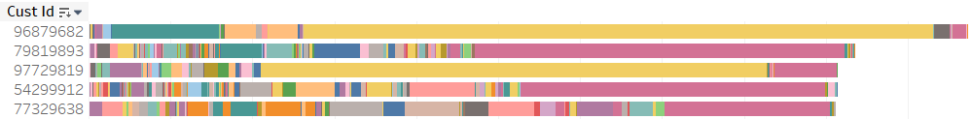
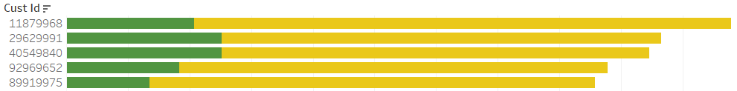

Customer trends emerge when looking at the top customers against others
Product sales amount
Customers that spent the most have stronger preferences in certain product categories
Number of transactions
Customers that have the most transactions do not prioritize discounts
No
Yes
Notes:
Interesting behaviours are found for top-sale customers. They have strong preferences in certain product categories, this kind of preferences are weaker for customers with less purchase. For these customers we might not need to offer too much discount

Slide 6
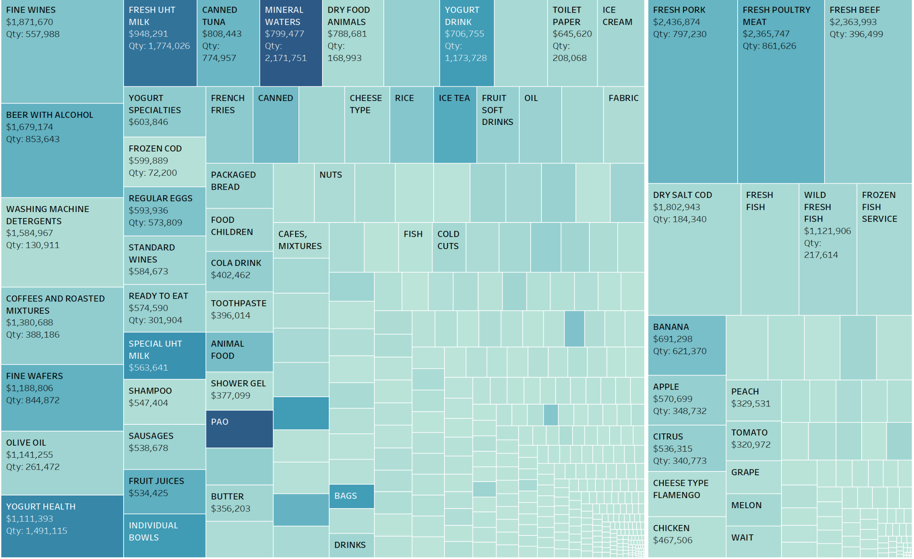
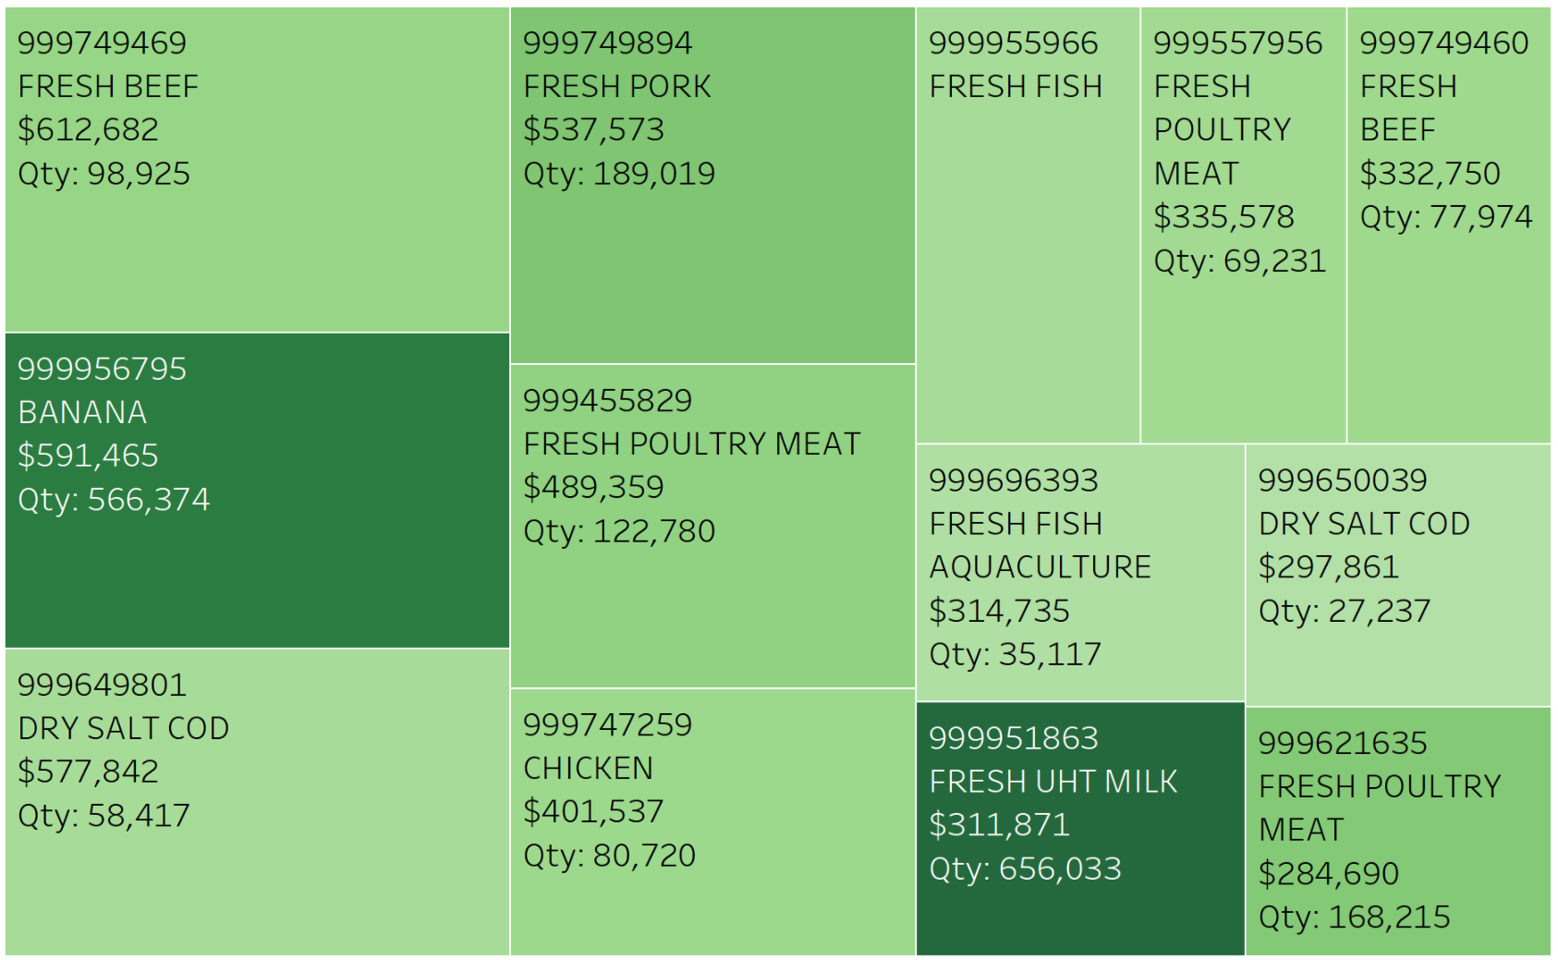
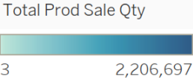
10% of product categories generate more than half of the supermarket’s sales
CT
Top Products
CT
CT (389)
KG
Product Categories

Slide 7
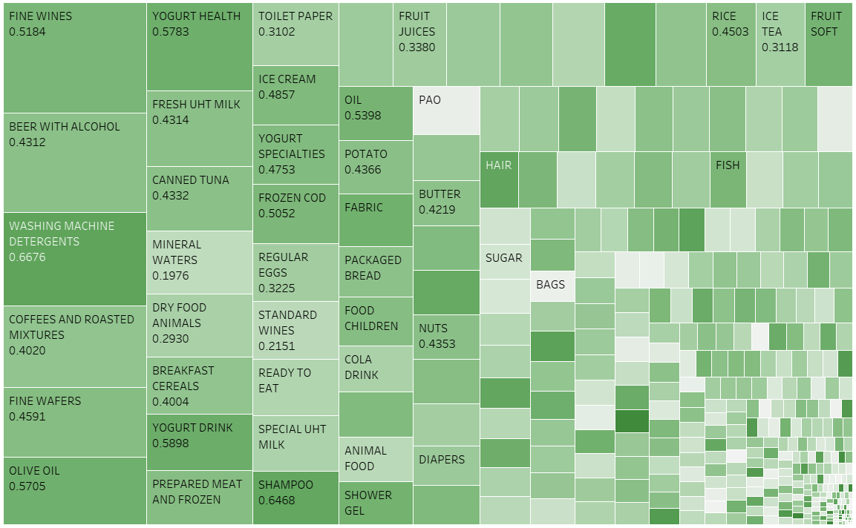
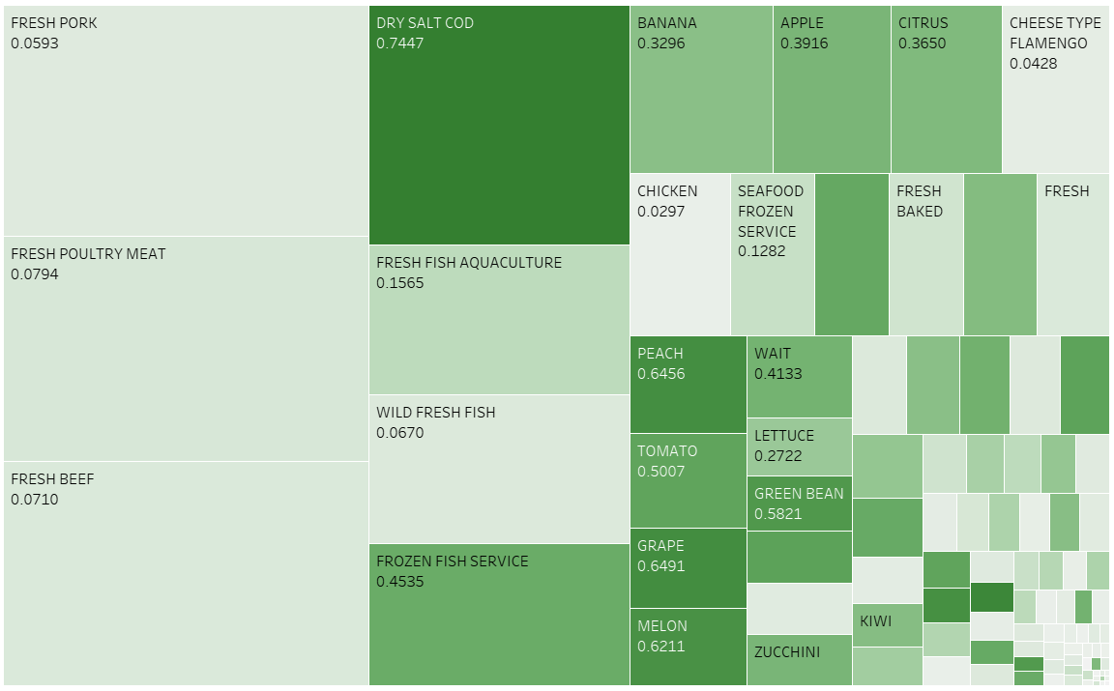

Different discount trends are found in products sold by weight vs those sold in units
CT
KG
Products with the largest sales have medium to high discount frequency (40% ~ 60%）
Products with the largest sales have larger variation in discount frequency
Notes:
Rarely on discount: pork, beef, poultry
Often on discount: seafood

Slide 8
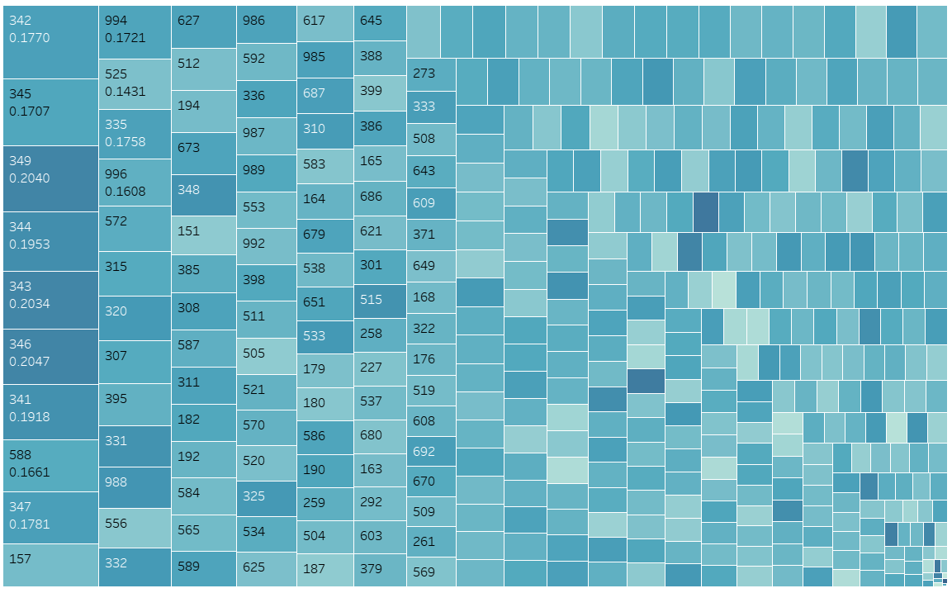
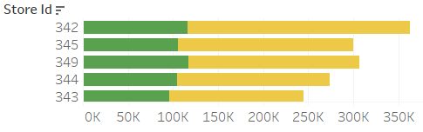

Stores ranking the highest in revenue typically offer more discounts
No
Yes

Slide 9
We prepared the data to perform different segmentations
Merged product table and transaction table to get category description
Standardized all the attributes for k-means clustering
Aggregated the data and created the following columns for use in segmenting customers, products, and stores
Customers:
discount_freq, discount_rate, product_types, total_spending, total_freq, month, weekend
Products:
mean_price, sum_sale_quantity, freq_of_discount_number, discount_ratio, weekends
Stores:
discount_count, discount_rate, discount_freq, total_sales, product_types

Slide 10
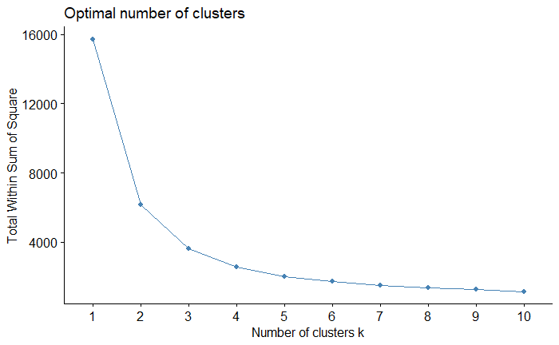
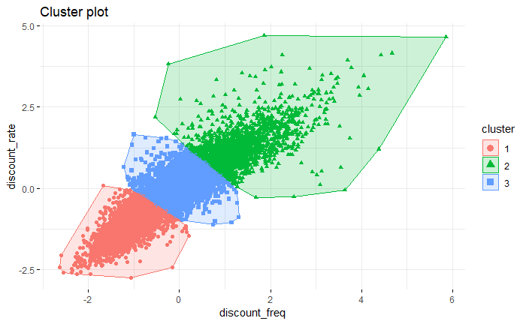
Customers were differentiated by discount rate and discount frequency
Plot gives us an optimal k of 3
Depiction of clusters

Slide 11
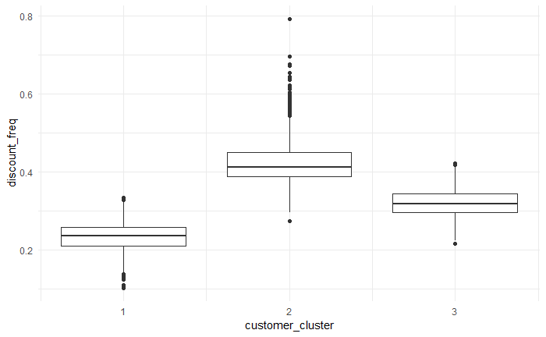
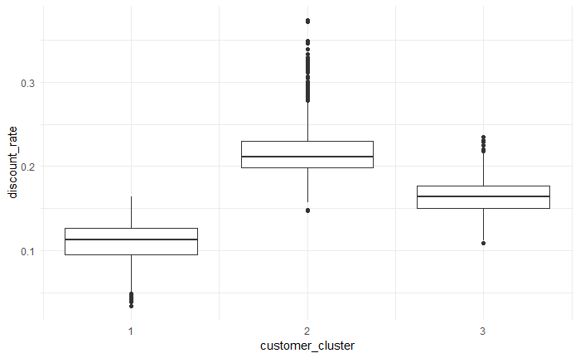
The customer segments display the difference between loyal customers and cherry pickers
Cluster | Discount Frequency | Product Types | Discount Rate | Total Spending | Total Frequency | Cluster Size | Comments
1 | 23.20% | 892 | 10.98% | 8011 | 49.19% | 2504 | Loyal customers– lowest discount rates
2 | 42.40% | 1050 | 21.70% | 7605 | 43.92% | 1901 | Cherry-pickers- high proportion of discount users
3 | 31.87% | 1016 | 16.40% | 7888 | 46.10% | 3445 | Middle of the road consumer (nothing special)
* Mean of each category per cluster
Boxplot of discount frequency
Boxplot of discount rate

Slide 12
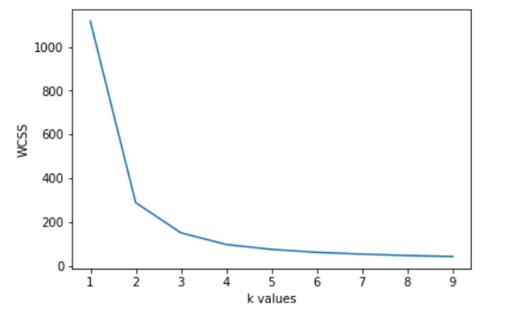
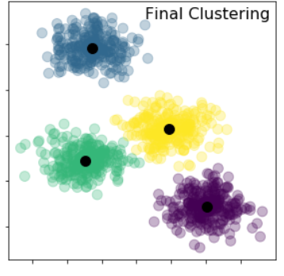
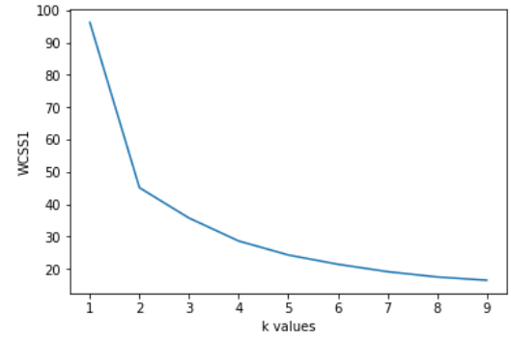
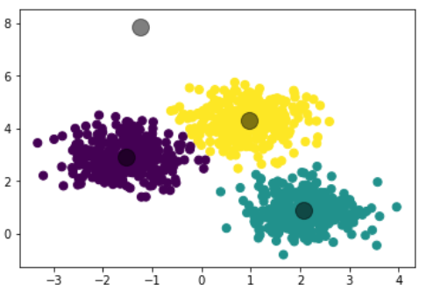
Products sold in different units (CT vs KG) are segmented differently
CT plot gives
optimal k of 4
KG plot gives
optimal k of 3

Slide 13
4 clusters are found for products in CT units
Cluster | Weekend Visit | Mean Price | Discount Rate | Quantity Sold | Discount Frequency | Cluster Size | Largest Category | 2nd Largest Category
1 | 31.89% | 2.90 | 1.94% | 5899 | 9.70% | 3236 | PAO MANUFACTURE | MINERAL WATERS
2 | 29.50% | 8.25 | 37.64% | 2488 | 77.10% | 1939 | YOGURT HEALTH | YOGURT DRINK
3 | 31.87% | 3.75 | 9.78% | 5530 | 34.57% | 2274 | FRESH UHT MILK | INDIVIDUAL BOWLS
4 | 30.35% | 5.37 | 22.15% | 2478 | 58.17% | 2293 | MINERAL WATERS | FRESH UHT MILK
* Mean of each category per cluster
Cluster 1: Lowest price, highest quantity, low discount, high daily demand, don’t require discounts to sell Cluster 2: High price, low quantity, like expensive dairy products, which require deep discounts to sell Cluster 3: Low price, medium quantity, low discount Cluster 4: Medium price, high discount, low quantity, life necessities (Mainly purchased on sales & in bulk)

Slide 14
3 clusters emerge for products sold in KG units
Cluster | Weekend Visit | Mean Price | Discount Rate | Quantity Sold | Discount Frequency | Cluster Size | Largest Category | 2nd Largest Category
5 | 41.24% | 11.19 | 1.71% | 820 | 9.79% | 205 | FRESH BAKED SEAFOOD | SEAFOOD FROZEN SERVICE
6 | 31.38% | 4.29 | 19.44% | 22166 | 56.77% | 157 | BANANA | APPLE
7 | 29.42% | 4.99 | 1.59% | 5309 | 7.08% | 673 | FRESH POULTRY MEAT | FRESH PORK
* Mean of each category per cluster
Cluster 5: Highest Price, low discount rate, not often on discount, speciality item. Cluster 6: Low Price with frequent discount, with high discount ratio, keep fresh and should be sold as quickly as possible (Needed with high demand like fruit) Cluster 7: Median price with low discount rate and frequency, consumed largely every day

Slide 15
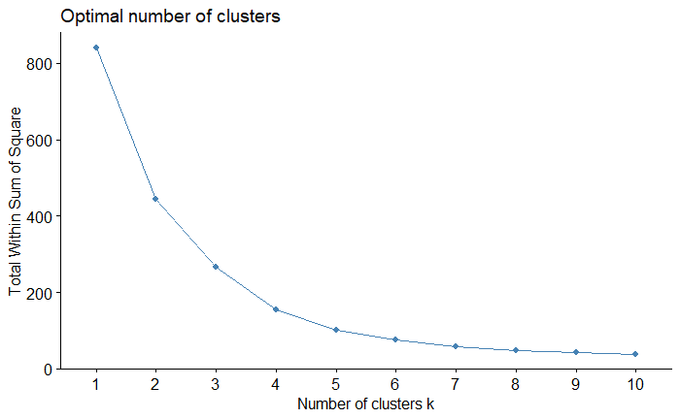
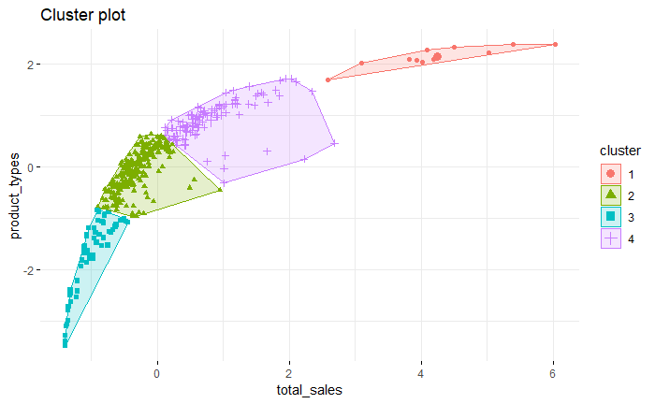
Store segmentation reveals 4 clusters, including one with high revenue and few stores
Plot gives us an optimal k of 4
Depiction of clusters

Slide 16
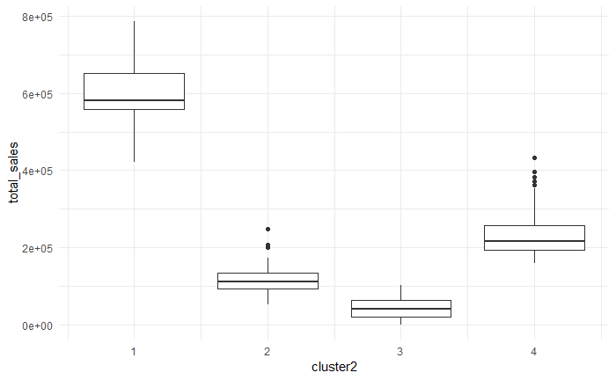
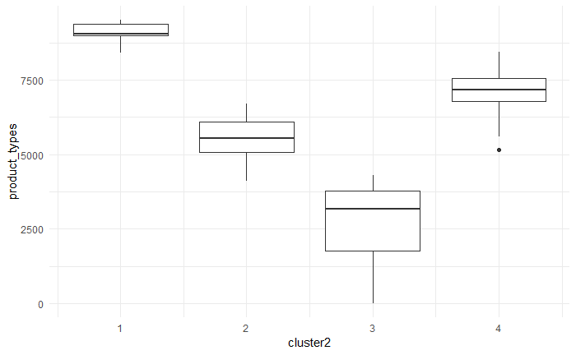
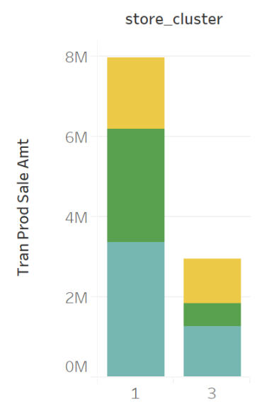
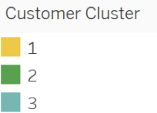
The clusters clearly show the stores frequented by cherry pickers and those by loyal customers
Cluster | Discount Rate | Discount Frequency | Total Sales | Product Types | Weekend Frequency | Cluster Size | Comments
1 | 18.02% | 34.90% | 597318 | 9141 | 40.52% | 11 | Largest stores frequented by cherry pickers
2 | 15.72% | 30.96% | 114515 | 5539 | 30.06% | 240 | “Typical” stores with average sales, product types and discount rates
3 | 14.42% | 29.41% | 42569 | 2822 | 25.20% | 61 | Small stores, frequented by loyal customers
4 | 16.01% | 31.09% | 234504 | 7143 | 31.95% | 109 | Large stores with average sales
* Mean of each category per cluster
Boxplot of total sales
Boxplot of product types
Store cluster 1,3 distribution

Slide 17
Next Steps: find who, what, where to target
Acquire additional data such as customer demographics and store information
Depending on the type of store to target at, customer to target to, and products to target with, we will move forward with a personalized pricing and promotion strategy
Using these insights, we can successfully create a marketing campaign that will boost Pernalonga’s revenue and profits

Slide 18

Thank you!
Questions?

